Slide 1

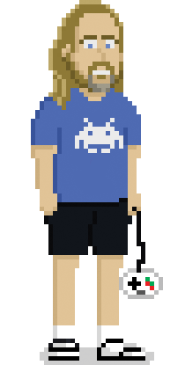
Teaching physics and simulations with Godot
Leszek Nowak
Teaching Assistant
Department of Information and Technologies
Jagiellonian University in Kraków
GodotCon Poznań, 10.10.2018

Slide 2
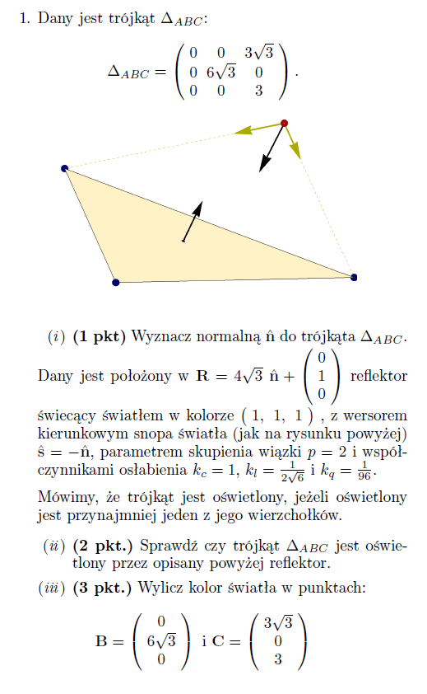
Teaching geometry
We have been through this.

Slide 3
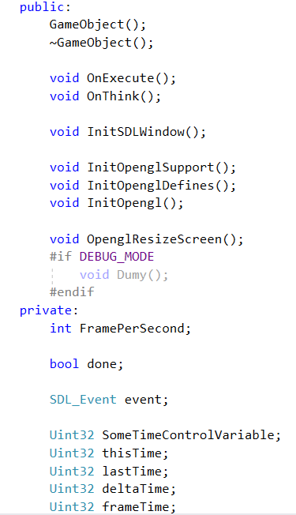
Writing your own engine
Why you should not do it.

Slide 4
Moving to Godot
uniform texture continents;
float scroll = TIME * 0.05;
vec2 normal = tex ( TEXTURE, UV ).rg - vec2( 0.5 );
vec2 cont_uv = vec2( scroll - UV.x * 0.2, UV.y * 0.65 + 0.175 );
vec3 c = tex( continents, cont_uv - normal * 0.2 ).rgb;
COLOR.rgb = c * ( 1.0 - length( normal ) );

Slide 5
Simple examples
Learn basic vector operations by programming steering in 2d

Slide 6
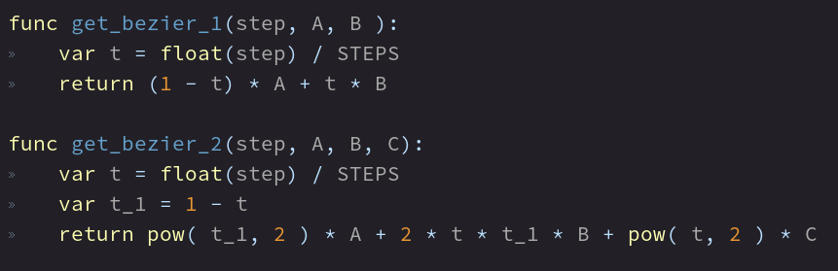
Getting from equation to code

Slide 7
Having some fun in the process
Solve interesting problems

Slide 8
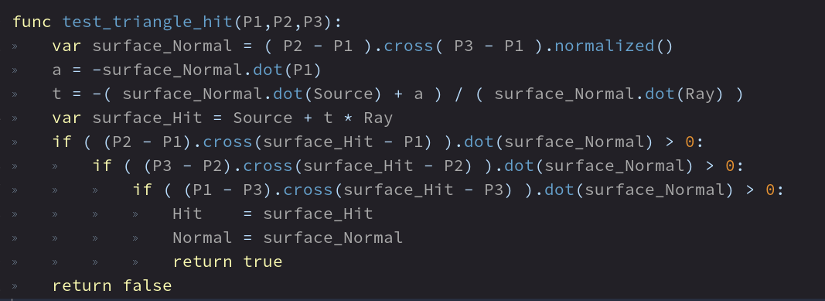
And there is 3d

Slide 9
Into simulations and physics
Last year testing

Slide 10
Hooke’s Law
Teaching this way proved to be fine

Slide 11
Wave Propagation

Slide 12
The project
Length 2 years
5+ faculty members
Additional teaching materials from Geometry, Physics and Simulation

Slide 13
The scope
Geometry
90 topics
e.g.:
Matrix operations
Principle Component Analysis
Curves (Bezier, Catmull-Rom, Hermite, B-Splines)
Shading (Gouraud, Phong, BRDF)
Separate Axis Theorem
Physics and Simulation
Over 130 topics
e.g.:
Forces Integrators (Velocity Verlet, Leap-frog, Runge-Kutta, Midpoint)
Flocking systems
Collisions
Mass-point systems
Computational Fluid Dynamics
Vehicle aerodynamics

Slide 14
What can we expect
Video for each of the topics containing:
Lecture
Example in Godot
Math solution

Slide 15
Contact
leszek.nowak@uj.edu.pl
http://www.doit.fais.uj.edu.pl/leszek-nowak
https://github.com/johnmeadow1
https://itch.io/profile/johnmeadow

